Slide 1


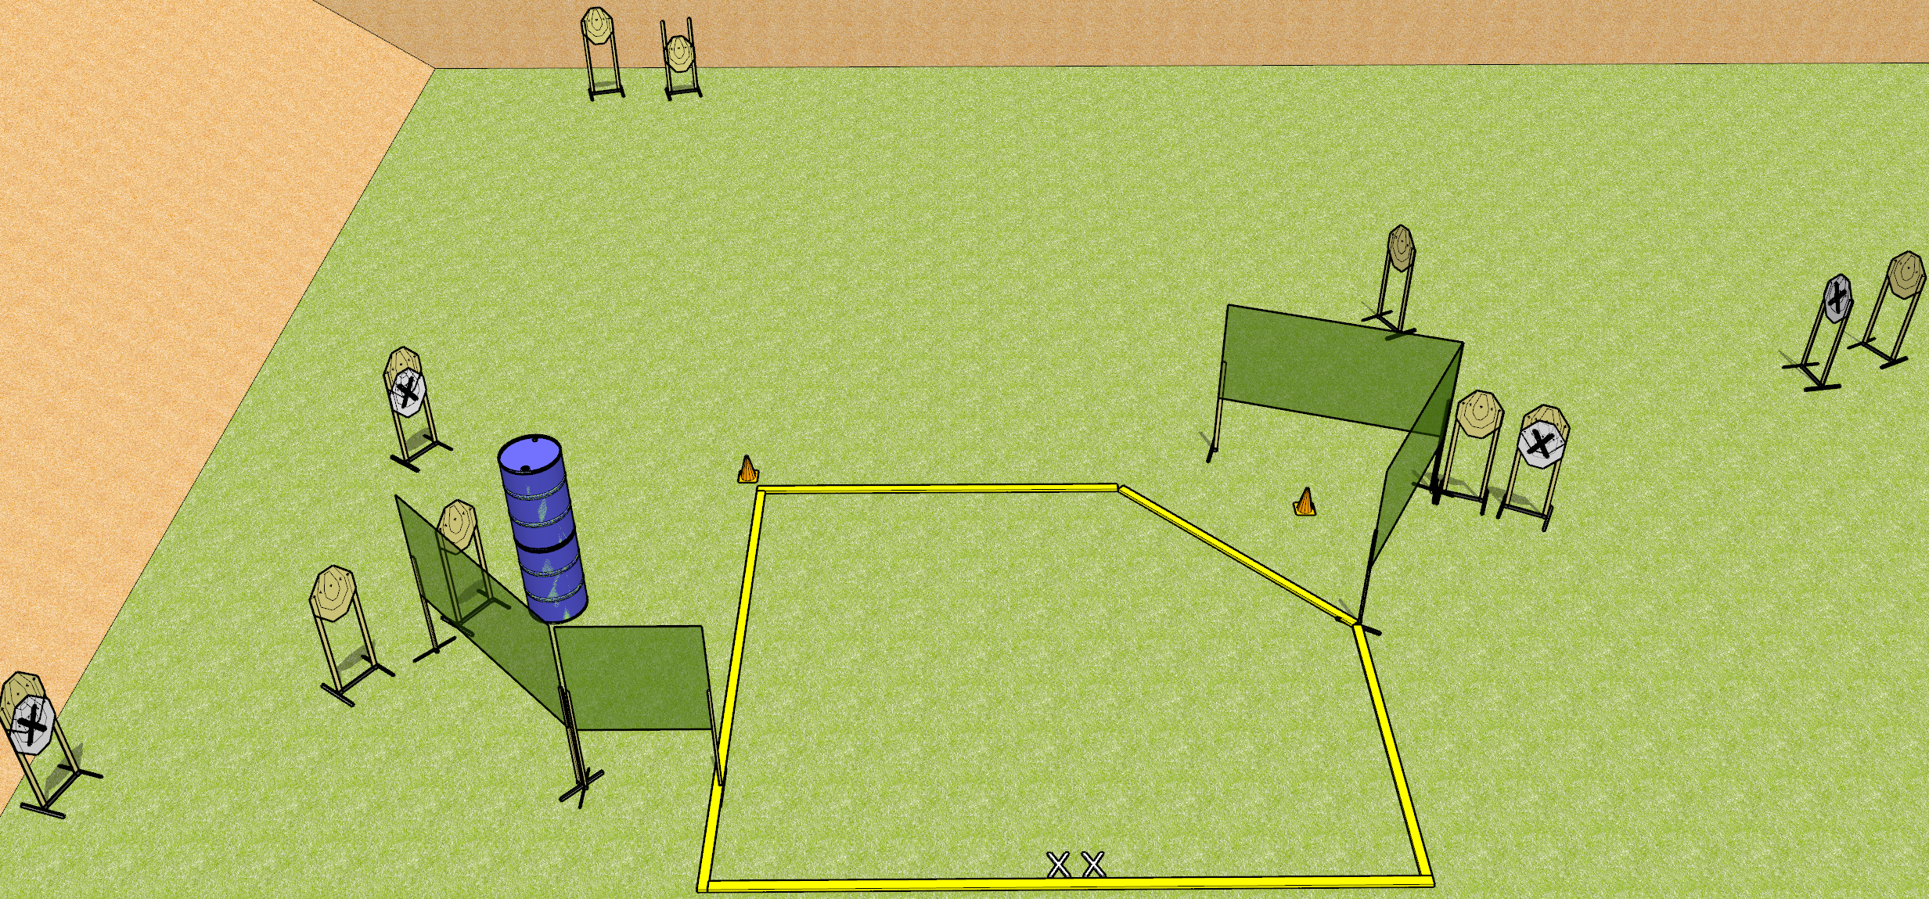
 | Dothan Gun Club – USPSA Match The Sickness Course Designer : Drew Coleman
START POSITION : Standing with both feet on X’s, wrists below belt
GUN READY CONDITION : Pistol loaded and holstered. PCC loaded, shouldered, safety on, pointed at either orange cone. |  | SCORING: Comstock, 20 rounds TARGETS: 10 paper, 0 Steel SCORED HITS: Best 2 on paper, steel until down START-STOP: Audible, last shot RULES:
STAGE PROCEDURE: Engage targets as they become available from within the fault lines.

Slide 2
The Sickness
Written Stage Briefing
The Sickness is a 20 round, 100 point, Comstock Medium Course. There are ten IPSC targets. The best two hits on paper will score. The start signal is audible.
Handgun start position is standing with both feet on X’s, inside the shooting area, wrists below belt. Handgun is loaded and holstered.
PCC start position is standing with both feet on X’s, inside the shooting area. Loaded carbine is held with both hands, safety on, pointed at either orange cone.
Upon start signal, engage targets as they become available from within the fault lines.

